Slide 1
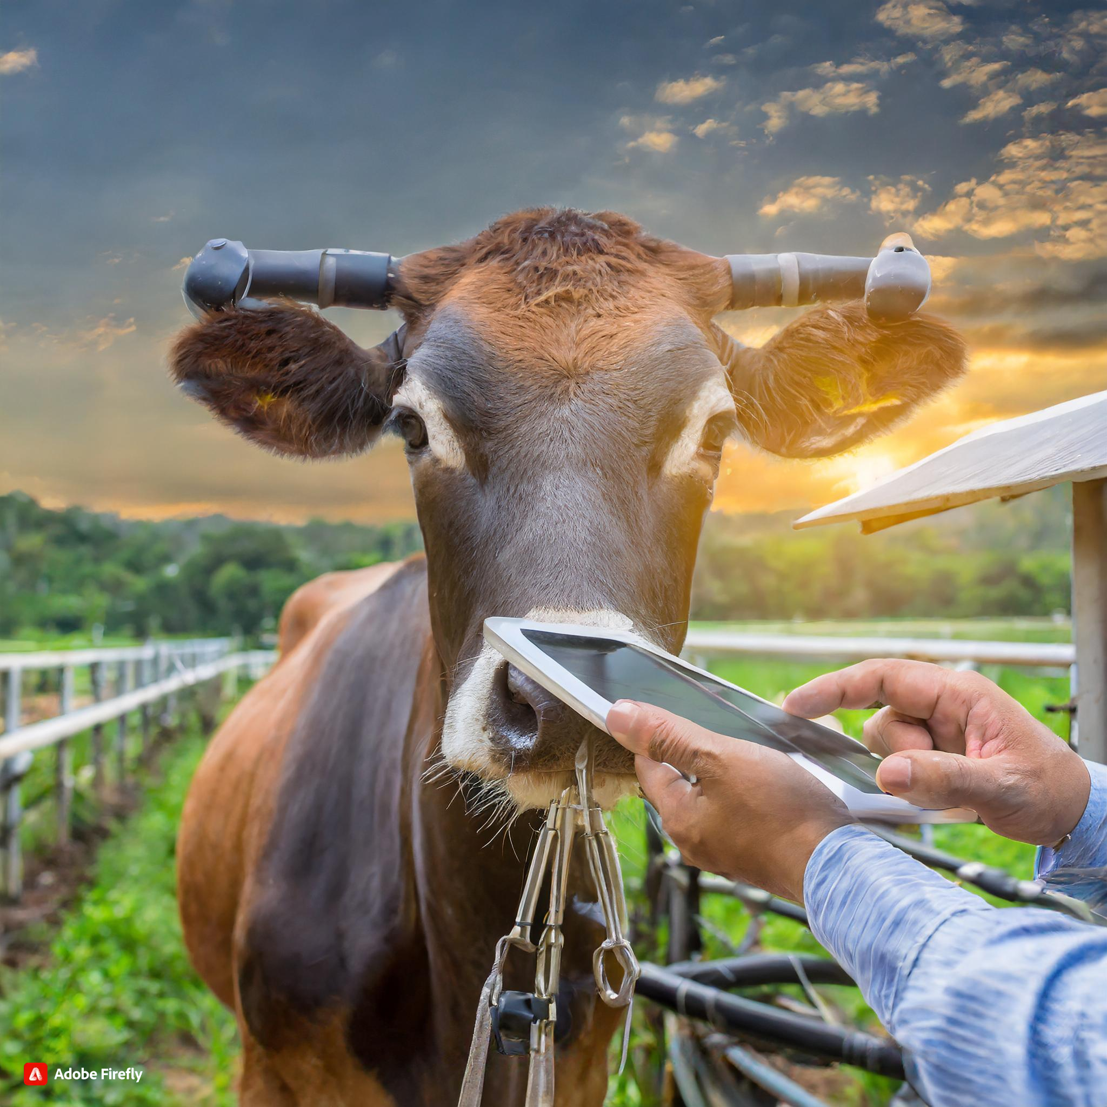
Iot-Smart cattle system
Lakshmi Kanth T M [1RR22MC022]
Divya K [1RR22MC006]

Slide 2
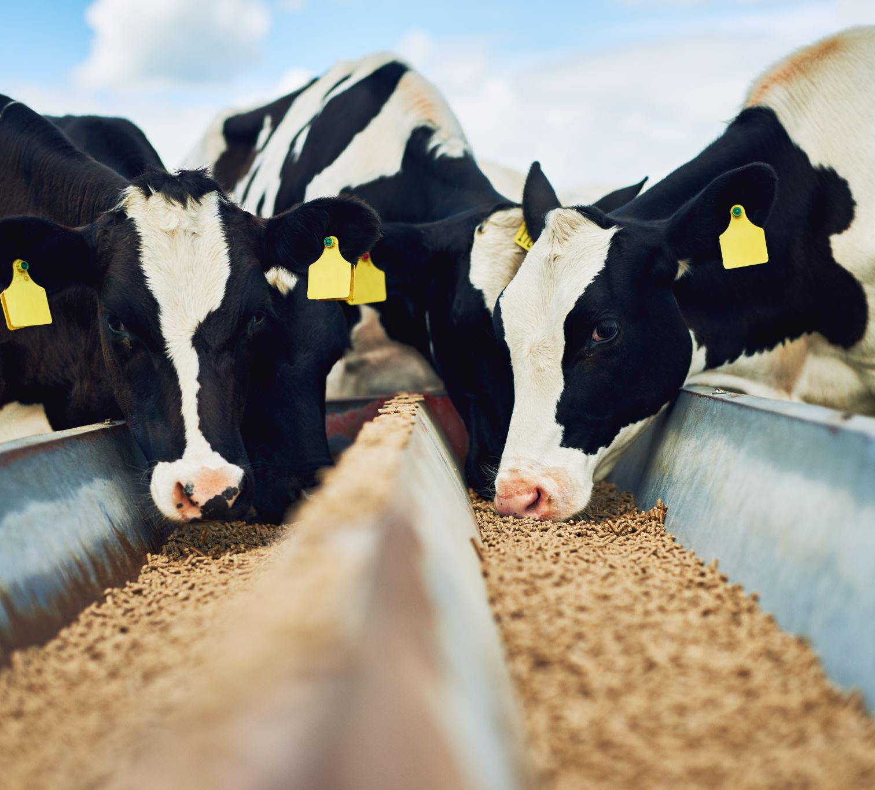
Introduction
A smart cattle system represents a modern and technologically advanced approach to managing and monitoring livestock.
It leverages cutting-edge technologies, including internet of things (IoT) devices, sensors, to enhance the overall efficiency of cattle farming.
By integrating these technologies, farmers can gain real-time insights into the health, behavior, and location of each individual animal.

Slide 3

Tumakuru: Cattle shed fire
CASE STUDY
Tumakuru, Jan 14: According to reports, an accidental fire broke out in a cattle shed in Kammanahalli village of Tumakuru Rural Constituency, resulting in the loss of 25 goats and 9 cows valued at lakhs of rupees. The shed, owned by a farmer named Chikkanna from Karahalli village, caught fire unintentionally.
Chikkanna mentioned that in addition to the livestock, various items such as a tractor, bike, 10 quintals of nuts, 600 coconuts, motor pump set cable, and a millet threshing machine were also destroyed in the fire. The estimated loss is around 30 lakh rupees.

Slide 4
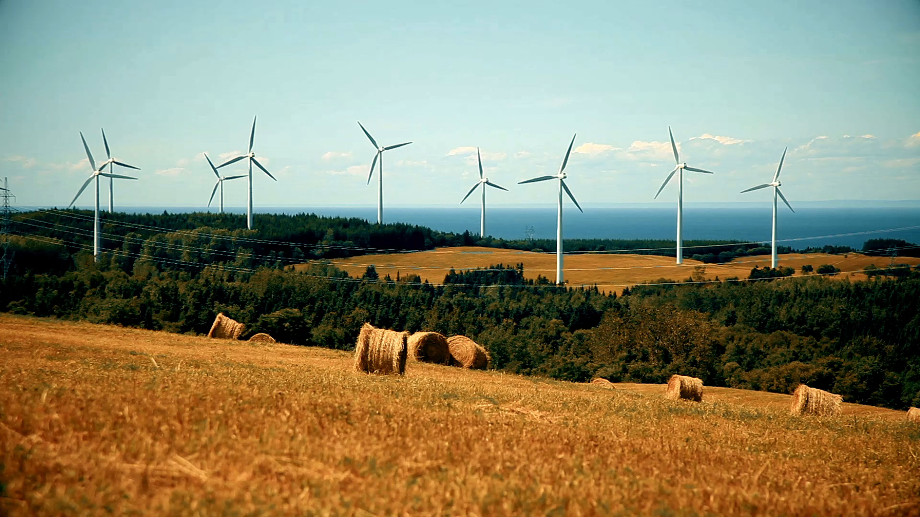
solution
Implementing an IoT-based smart cattle system utilizing GPS trackers, fire and smoke sensors, automatic door sensors, and moisture sensors is a strategic choice aimed at revolutionizing traditional cattle farming practices.
The GPS trackers offer precise location monitoring, facilitating efficient grazing management and ensuring the safety of the herd. Integrating fire and smoke sensors adds a layer of security, promptly alerting farmers to potential threats and minimizing the risk of losses due to unforeseen incidents.
Automatic door sensors streamline access control, enhancing security and ensuring a controlled environment. Additionally, moisture sensors contribute to optimized feeding practices by monitoring environmental conditions.
This comprehensive approach not only improves operational efficiency but also empowers farmers with real-time data insights for informed decision-making, ultimately elevating the overall productivity and sustainability of cattle farming.

Slide 5
Applications Of Smart Cattle System
Early Fire Detection
Environmental Monitoring
Location Tracking
Using fire and smoke sensors, the system can detect wildfires or on-farm fires early.
Utilizing moisture sensors to monitor environmental conditions.
Integration of GPS trackers for precise location monitoring.

Slide 6
Hardware and software specifications
hardware requirements
software requirements
Arduino Programming Board
GPS Module
Sensors :
Motion Sensor PIR or RFID [Radio- Frequency Identification]
Fire and Smoke Sensors
Moisture Sensor
Arduino IDE
GPS Module Libraries [TinyGPS or TinyGPS++]
Programming Language [C or C++]

Slide 7
conclusion
A smart cattle system employs technologies like IoT sensors and GPS tracking to monitor and manage the health, location, and behavior of livestock, enabling farmers to make informed decisions for efficient livestock management.

Slide 8
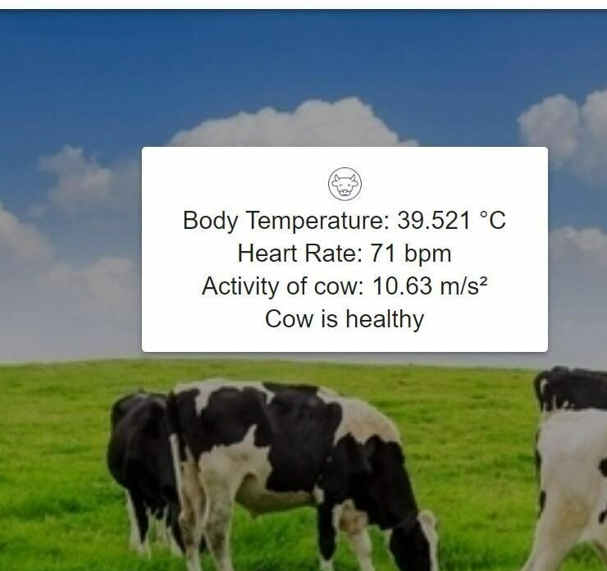
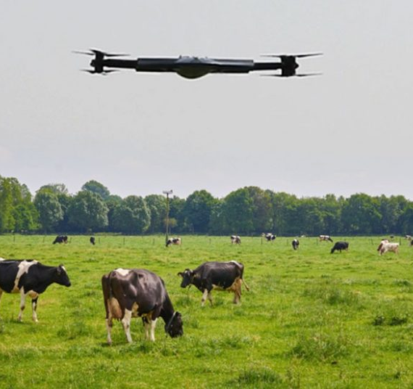
Future scope
Enhanced animal health and welfare: Sensors embedded in collars, feed bunks, or even implanted in animals can continuously track vital signs like temperature, heart rate, respiration, and movement. This data can be used to identify early signs of illness, allowing for prompt intervention and improved treatment outcomes.
Optimized farm management:Drones equipped with AI can monitor pasture health, track herd movement, and even detect strays, streamlining daily operations and reducing labor costs.

Slide 9
THANK YOU 🙏

